Slide 1
Reinforcement Learning Based Particle Swarm Optimization
Brandon Ooi
lr2175@inf.elte.hu

Slide 2
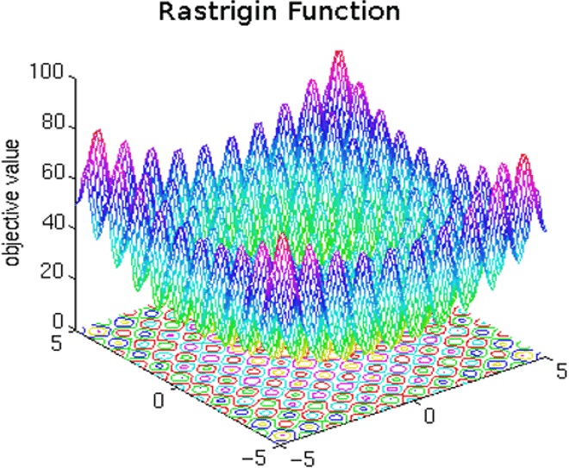
Optimization Problems
Given a particular function
Find the location with the best fitness value
Can be complex
Can be noisy
Can model real world situations
Image(s)
Baseline-Free Sampling in Parameter Exploring Policy Gradients: Super Symmetric PGPE - Scientific Figure on ResearchGate. Available from: https://www.researchgate.net/figure/sualization-of-the-2D-Rastrigin-function_fig13_280713328 [accessed 13 Dec, 2023]

Slide 3
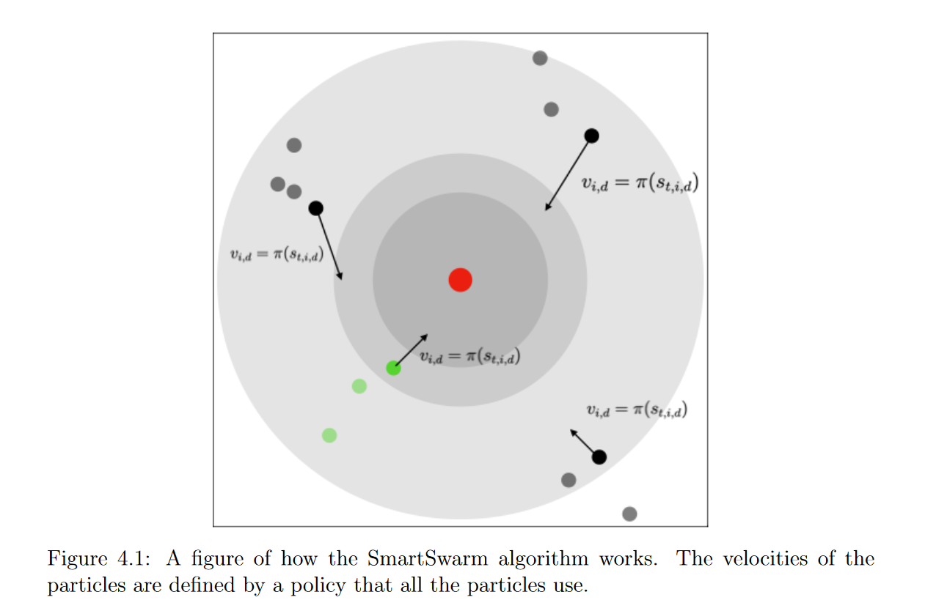
SmartSwarm
Literature that combines Reinforcement Learning with Particle Swarm
Uses reinforcement learning to update velocity vector
Each dimension has it’s own velocity
Results better in 2nd dimension but not very robust in high dimensions

Slide 4
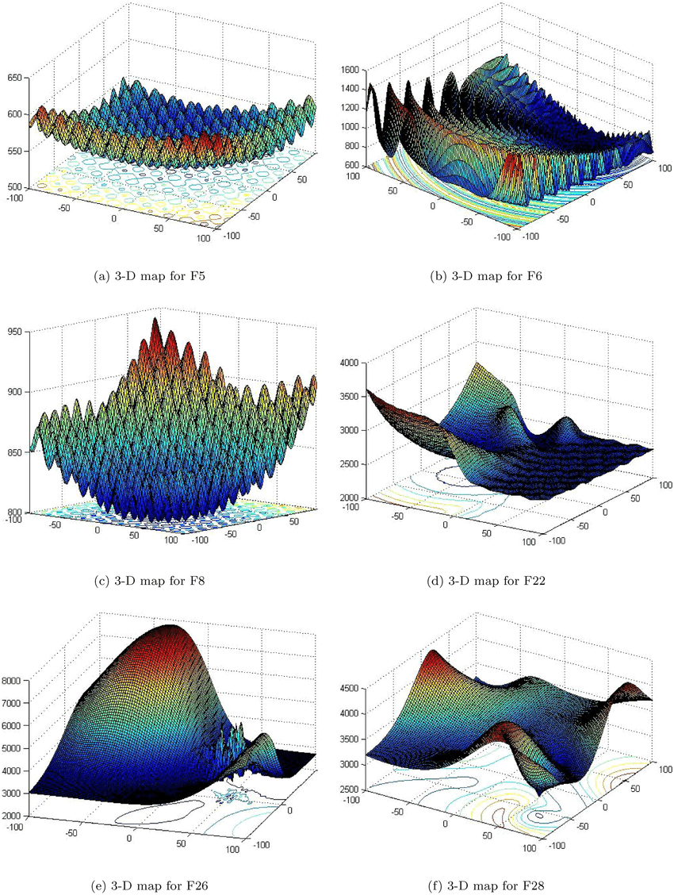
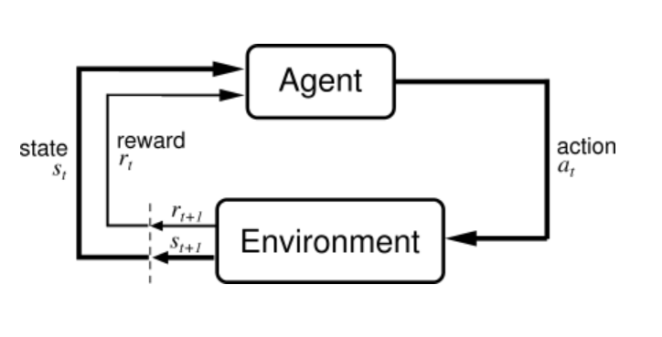
Environment
PettingZoo
Gymnasium
Individuals created
Storing coordinates
Fitness values
Velocity
Variable Dimensionalities
Different functions
10 CEC2017 Simple functions
Dimension 2,10,20,30,50,100
Dimension learning based chimp optimizer for energy efficient wireless sensor networks - Scientific Figure on ResearchGate. Available from: https://www.researchgate.net/figure/3-D-graphs-of-CEC2017-test-suites_fig1_363238609 [accessed 13 Dec, 2023]

Slide 5

Observation spaces
Distance to Global Best
Distance to Current Best
Distance to Worst
Velocity
Iteration Number

Slide 6
Action spaces
Move towards particle best by distance* [0.5,1.0] + existing velocity * [0.5,0.1]
Move towards particle best by distance* [0.5,1.0] + existing velocity * [0.5,0.1]
Cruise without changing velocity
Move away from worst by distance [0.5,1.0] + existing velocity * [0.5,0.1]
Add random movement to current velocity

Slide 7

Rewards
2 trials:
-log(current fitness/ initial average fitness)
-log(current fitness/ weighted average fitness)
Weighted average fitness scales initial average with current average
Weighted Average fitness was used

Slide 8
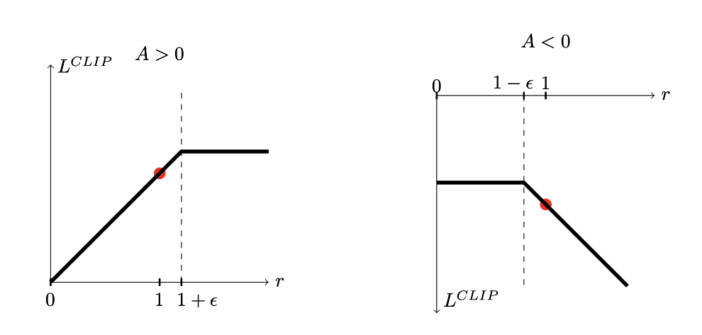
Models and Policies
Models
Multi-Agent Reinforcement Learning
MLP
Policies
PPO
Trained with 1 million time steps
random function
random dimensionality.

Slide 9

Evaluation
Average Fitness Values
100 trials
10 Functions
6 dimensionalities
Against PSO (pyswarm)

Slide 10
Results
2 | 10 | 20 | 30 | 50 | 100
5.83E+08 | 2.77E+11 | 6.91E+11 | 1.38E+12 | 2.72E+12 | 6.49E+12 | 1rl
7.54E+10 | 2.95E+11 | 5.03E+11 | 8.48E+11 | 1.35E+12 | 2.96E+12 | 1pso
2.42E+02 | 1.74E+16 | 5.20E+36 | 2.82E+56 | 6.34E+96 | 1.03E+205 | 2rl
4.91E+02 | 8.10E+17 | 3.32E+37 | 2.04E+61 | 5.24E+87 | 1.83E+191 | 2pso
1.01E+04 | 3.12E+07 | 8.58E+08 | 2.96E+10 | 1.14E+12 | 2.80E+13 | 3rl
5.01E+06 | 2.22E+05 | 1.91E+12 | 2.23E+09 | 1.59E+14 | 1.64E+14 | 3pso
4.02E+02 | 4.18E+03 | 1.25E+04 | 6.09E+04 | 1.26E+05 | 3.41E+05 | 4rl
4.75E+02 | 5.78E+03 | 1.50E+04 | 3.40E+04 | 5.67E+04 | 1.59E+05 | 4pso
5.05E+02 | 6.66E+02 | 8.59E+02 | 1.23E+03 | 1.76E+03 | 3.21E+03 | 5rl
5.14E+02 | 7.15E+02 | 8.84E+02 | 1.13E+03 | 1.35E+03 | 2.36E+03 | 5pso
6.20E+02 | 7.10E+02 | 7.40E+02 | 7.81E+02 | 8.11E+02 | 8.02E+02 | 6rl
8.96E+02 | 7.38E+02 | 7.24E+02 | 7.98E+02 | 7.90E+02 | 7.49E+02 | 6pso
7.07E+02 | 1.23E+03 | 2.29E+03 | 3.60E+03 | 6.31E+03 | 1.38E+04 | 7rl
7.02E+02 | 8.76E+02 | 1.19E+03 | 1.64E+03 | 2.19E+03 | 4.31E+03 | 7pso
8.06E+02 | 9.45E+02 | 1.15E+03 | 1.43E+03 | 2.03E+03 | 3.68E+03 | 8rl
8.14E+02 | 9.39E+02 | 1.10E+03 | 1.32E+03 | 1.70E+03 | 2.82E+03 | 8pso
9.31E+02 | 4.43E+03 | 1.47E+04 | 3.37E+04 | 9.68E+04 | 2.20E+05 | 9rl
1.08E+03 | 4.68E+03 | 7.24E+03 | 2.07E+04 | 5.60E+04 | 1.14E+05 | 9pso
1.11E+03 | 3.59E+03 | 7.14E+03 | 1.09E+04 | 1.80E+04 | 3.67E+04 | 10rl
2.15E+03 | 5.97E+03 | 9.72E+03 | 1.08E+04 | 2.10E+04 | 3.66E+04 | 10pso

Slide 11
Evaluation of Results
Fared better on lower dimensions, but over 30 dimensions performed poorer than PSO
2dim – 9/10
10dim – 7/10
20dim – 5/10
30,50,100 - <3/10, though still mostly comparable to PSO
Successful improvement on SmartSwarm

Slide 12
Conclusion and Further Work
Conclusion
Good Results
Similar time complexity to PSO
After training, equal number of objective function evaluations
High improvement over PSO in lower dimensions
Comparable to PSO up to 50 dimensions
Further Work
Improve Observation Space
Further Hyperparameter Testing
Incorporate ensemble learning via different optimizers in Action Space

Slide 13
Thank You for Your Attention!
Brandon Ooi
LR2175@inf.elte.hu
Questions?

